Slide 1
dotnet CORE
DEVROCK#04 LAST UPDATE 2016
CHALERMPON AREEPONG
Microsoft MVP and Community Founder

Slide 2
Agenda
Overview .NET Framework
.NET CORE 1.0
.NET CORE 1.1

Slide 3
.NET Framework
First announce on 2002
Dot Net Framework v1.0 – v4.6.2
BCL, CLR, GC
Running on Windows OS PC, Server and Mobile
App Models
Console
Windows App
Windows Service
ASP.NET
Windows Universal App

Slide 4

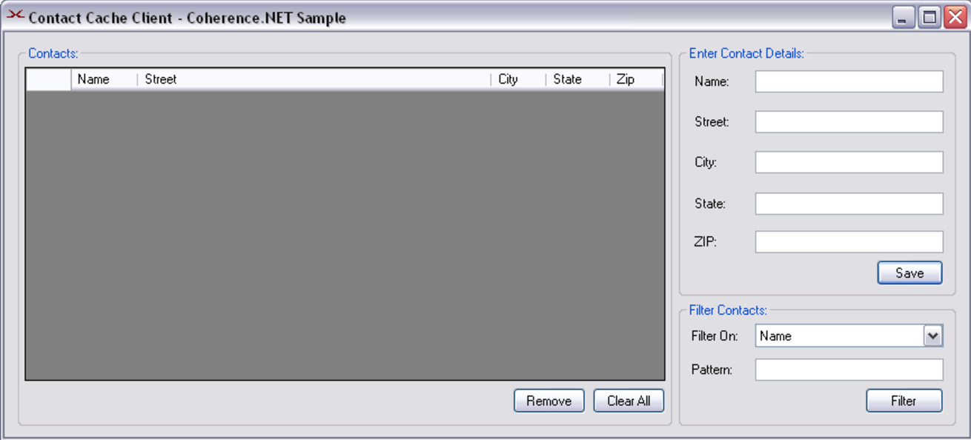
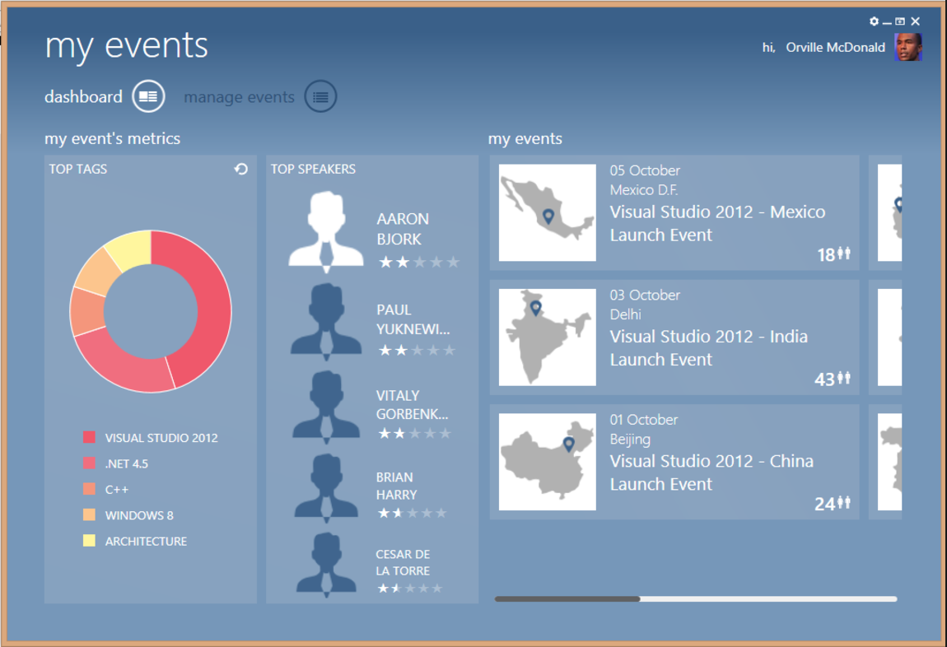
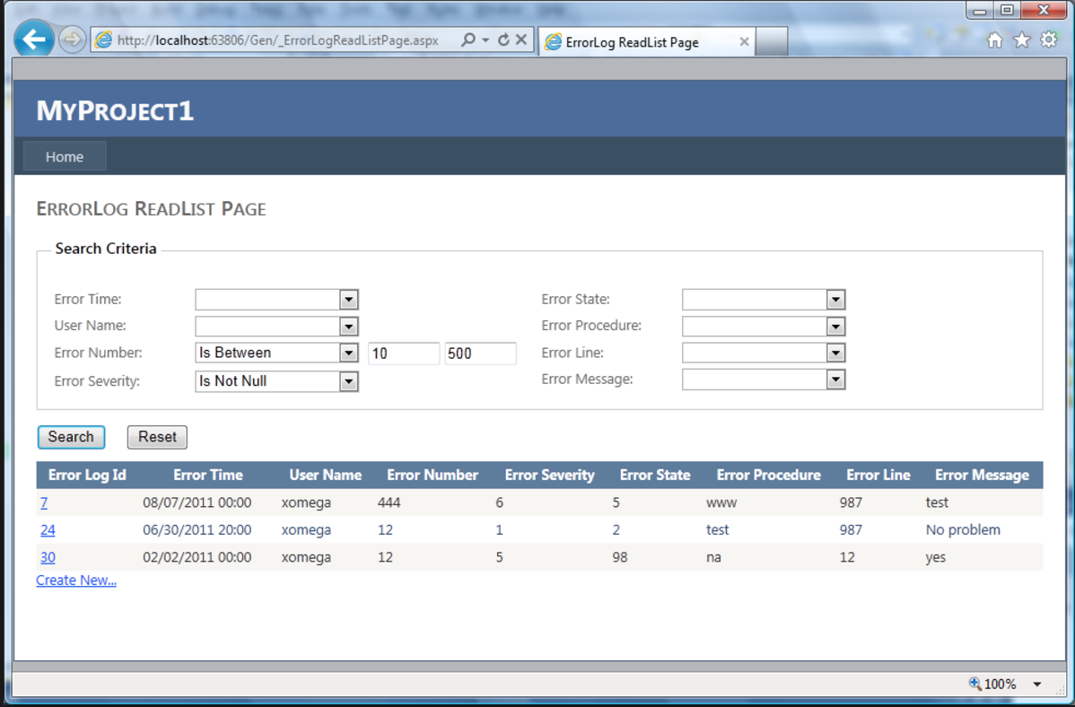
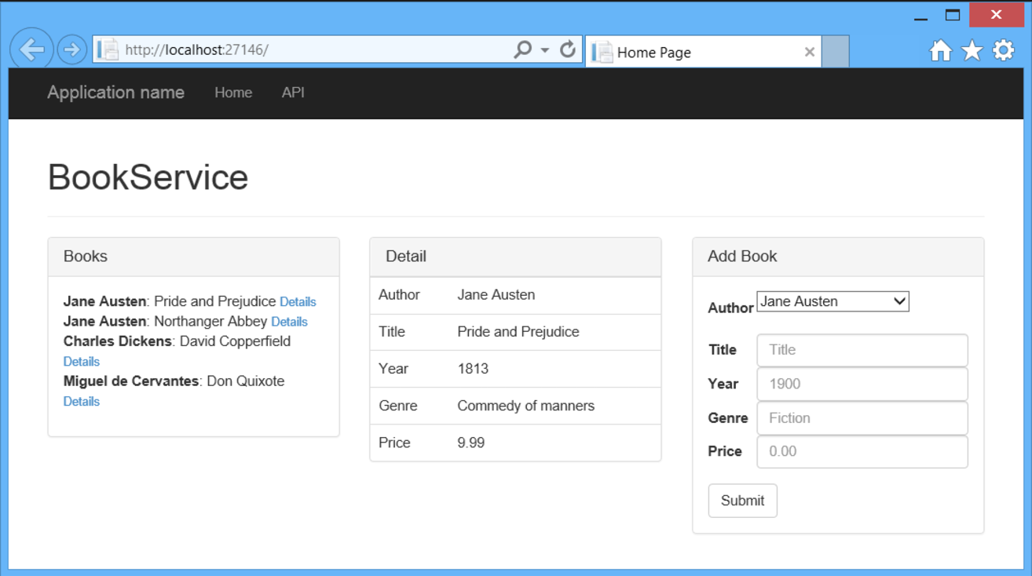
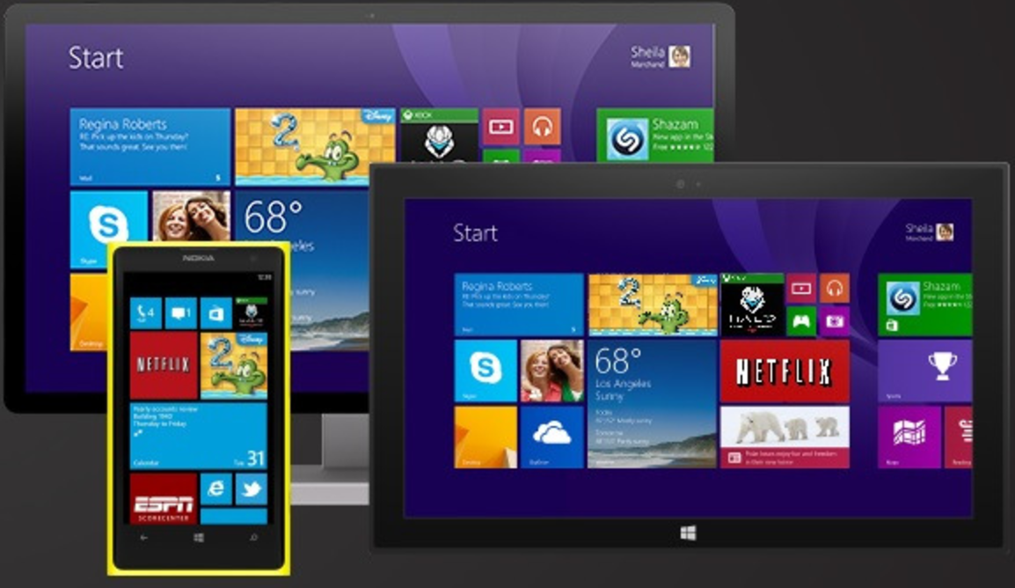

Slide 5
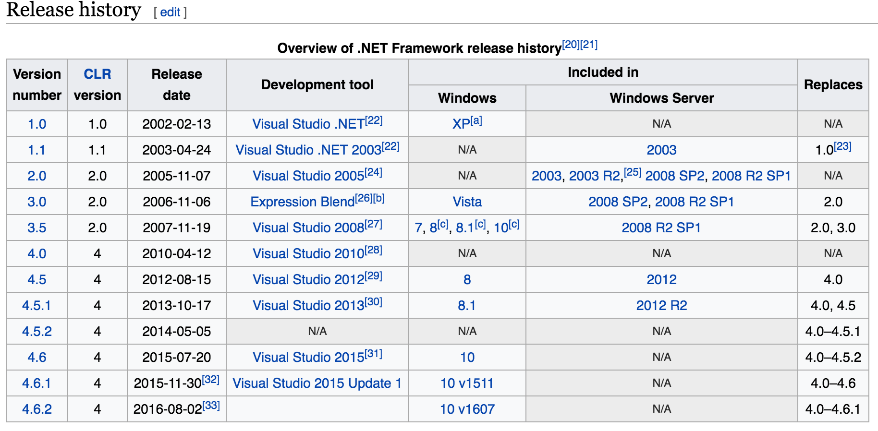

Slide 6
Another .NET Framework
.NET Micro Framework
Mono Framework
Portable.NET
CrossNet

Slide 8
Hello => .NET CORE

Slide 9
.NET Core Journey
ASP.NET user request run on Linux and new Target Window Nano then they start with Project K
First Preview announced on Q4 2014
KRE, KVM, KPM
Second Q1 2015
DNX, DNVM, DNU
.NET Core v1.0 and .NET Standard RTM on 27 June 2016
dotnet new, restore, run, …
REDHAT join .NET Foundation to help .NET App running on RHEL
Samsung join .NET Foundation contribute .NET core in area of ARM support

Slide 10
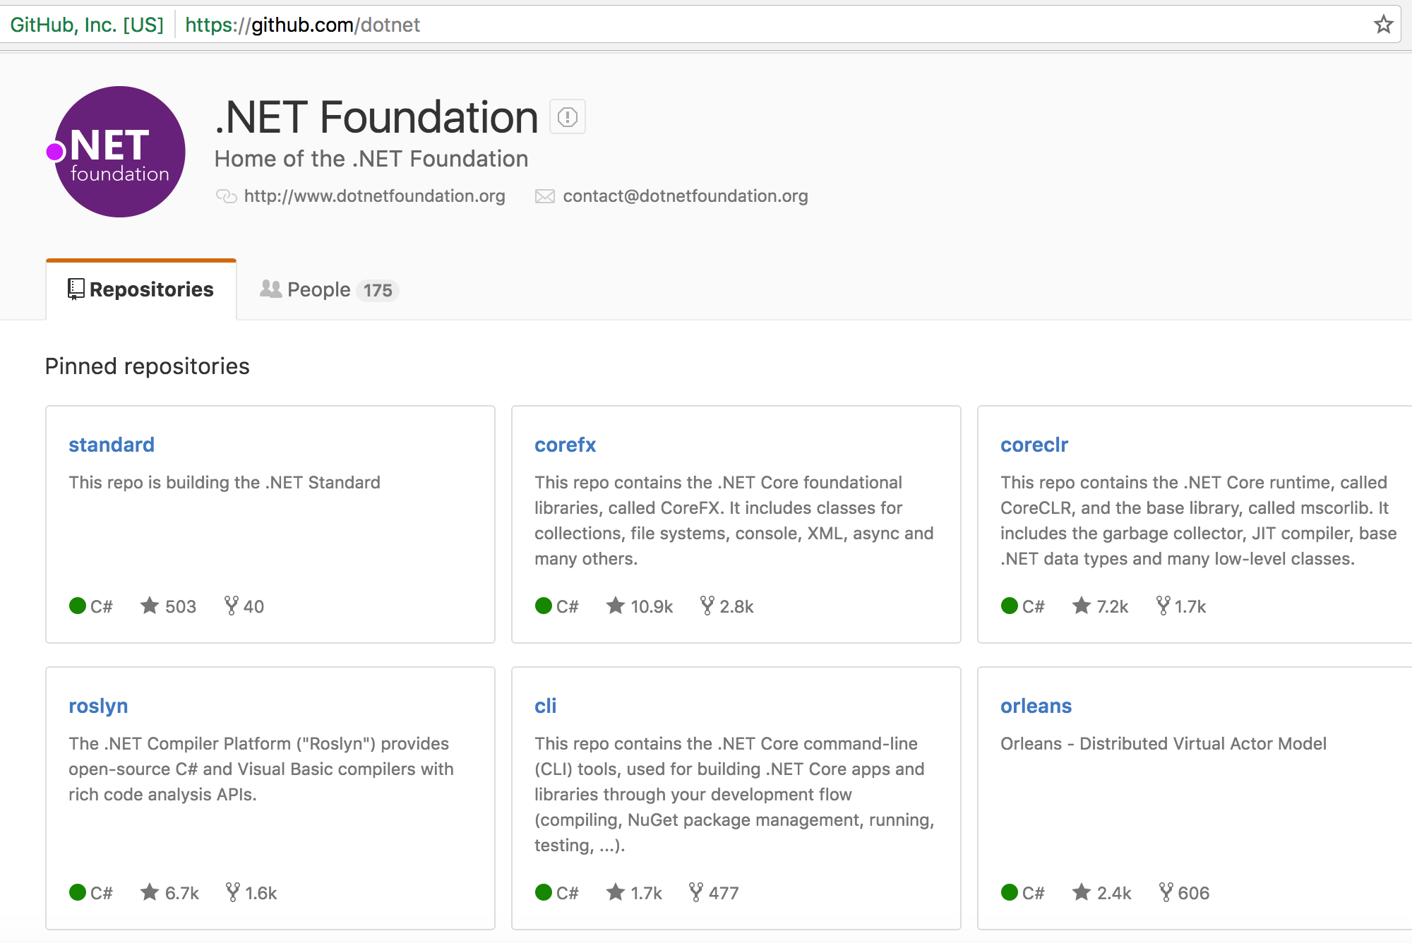

Slide 11
.NET Core 1.0 Overview
Cross-platform => macOS, Linux, Windows
Flexible deployment: Side by side, docker
Compatible: all .NET Frameworks with .NET Standard Library
Command-line tools
Open source: MIT and Apache 2 licenses. Documentation is licensed under CC-BY
Supported by Microsoft .NET Core Support

Slide 12
.NET CORE v1.0
CORE CLR or .NET runtime : type system, assembly loading, a garbage collector, native interop and other basic services.
CORE FX or framework libraries : which provide primitive data types, app composition types and fundamental utilities.
.NET Core SDK : contains CLI SDK tools and Roslyn language compilers that enable the base developer experience
The ‘dotnet’ app host, which is used to launch .NET Core apps. It selects and hosts the runtime, provides an assembly loading policy and launches the app. The same host is also used to launch SDK tools in the same way.

Slide 13
.NET Core 1.0 Packages
.NET Core: runtime and framework. The current version is “.NET Core 1.0”
.NET Core SDK: SDK and Tools. The current version is “.NET Core SDK 1.0 Preview 2”.

Slide 14
.NET Core 1.0 Workloads
Console App
ASP.NET Core
Windows 10 UWP
Xamarin.Forms

Slide 15
Performance
Illyriad Games, the team behind Age of Ascent, reported a 10-fold increase in performance using ASP.NET Core with Azure Service Fabric. We are also extremely greatful for their code contributions to this performance. Thanks @benaadams!
NetEase, a leading IT company in China, provides online services for content, gaming, social media, communications and commerce, needed to stay on the leading edge of the ever-evolving mobile games space and chose .NET Core for their back end services. When compared to their previous Java back-end architecture: “.NET Core has reduced our release cycle by 20% and cost on engineering resources by 30%.”When speaking about the throughput improvements and cost savings: “Additionally, it has made it possible to reduce the number of VMs needed in production by half.”
Our lab, We see throughput that is 8x better than Node.js and almost 3x better than Go, on the same hardware. We’re also not done! These improvements are from the changes that we were able to get into the 1.0 product.

Slide 16
Cross Platform Ready?

Slide 17
New Picture

Slide 18
Introduce .NET Standard Library 1.0
One Standard APIs for All .NET Platform, independent of workload
Application: same API for all platform

Slide 19
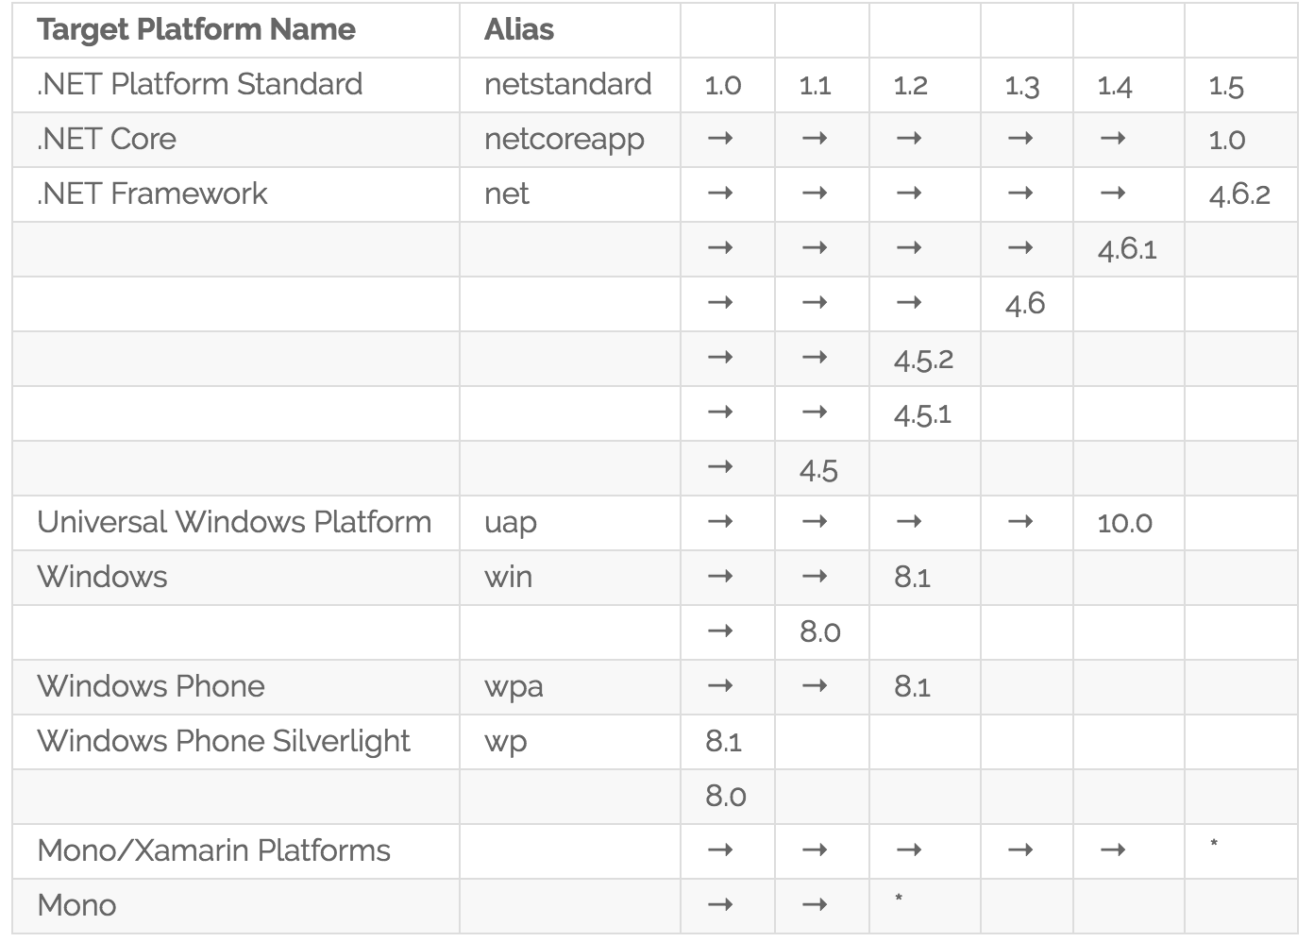
.NET Standard Library v1

Slide 20
.NET CLI Tools
dotnet new – Initializes a sample console C# project.
dotnet restore – Restores the dependencies for a given application.
dotnet build – Builds a .NET Core application.
dotnet publish – Publishes a .NET portable or self-contained application.
dotnet run – Runs the application from source.
dotnet test – Runs tests using a test runner specified in the project.json.
dotnet pack – Creates a NuGet package of your code.dotnet works great

Slide 21
ASP.NET CORE 1.0
Build and run cross-platform ASP.NET apps on Windows, Mac and Linux
Built on .NET Core, which supports true side-by-side app versioning
New tooling that simplifies modern Web development
Single aligned web stack for Web UI and Web APIs
Cloud-ready environment-based configuration: Redis, UseSecretKey, Connection String
Built-in support for dependency injection
Tag Helpers which makes Razor markup more natural with HTML
Ability to host on IIS or self-host in your own process

Slide 22
ASP.NET CORE 1.0
Visual Studio 2015 SP3, Visual Studio 2017
.NET CLI
dotnet new -t web
dotnet restore
dotnet run
Yeoman
yo aspnet

Slide 23
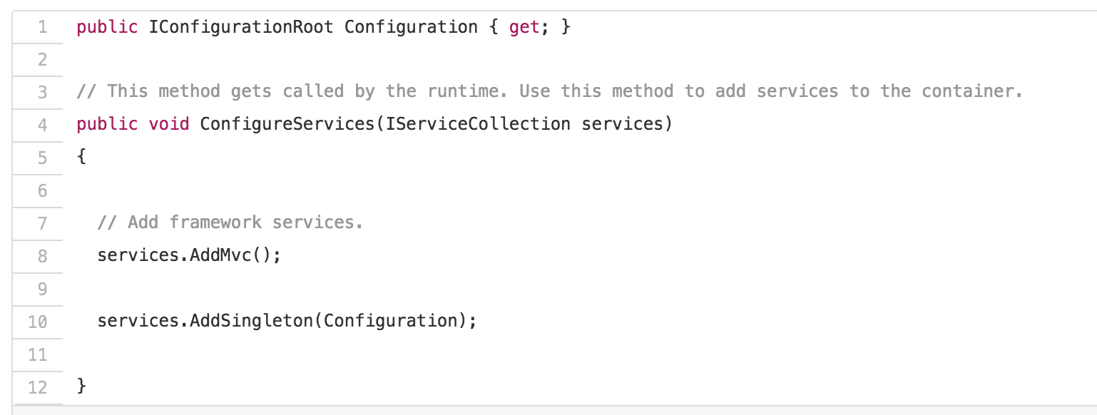
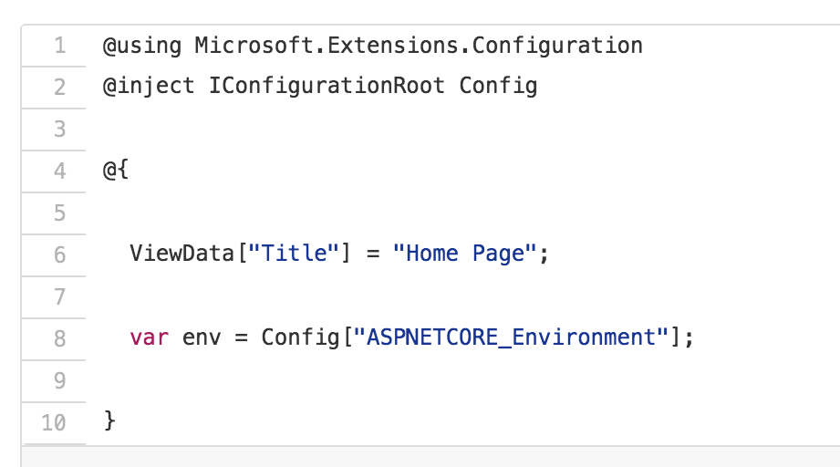
ASP.NET CORE 1.0 Feature
Dependency Injection Everywhere

Slide 24
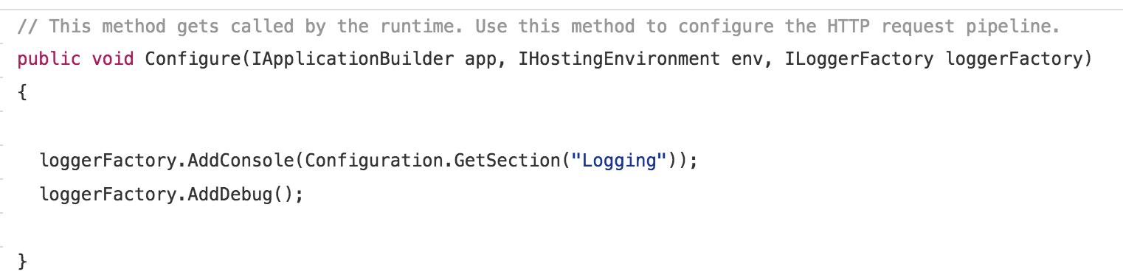
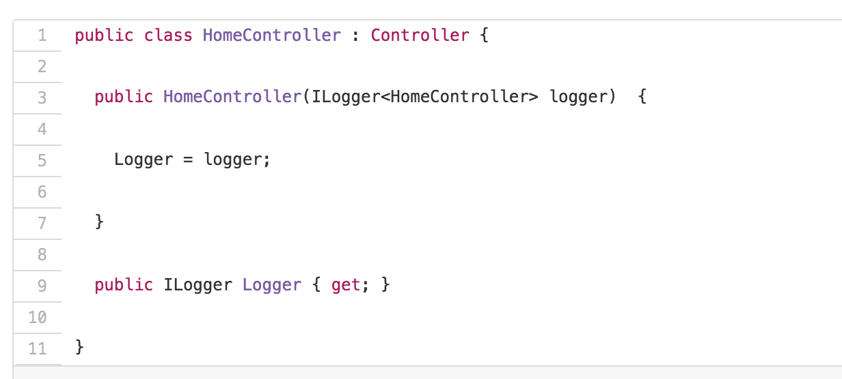
ASP.NET CORE 1.0 Feature
Standard Logging is a Snap

Slide 25
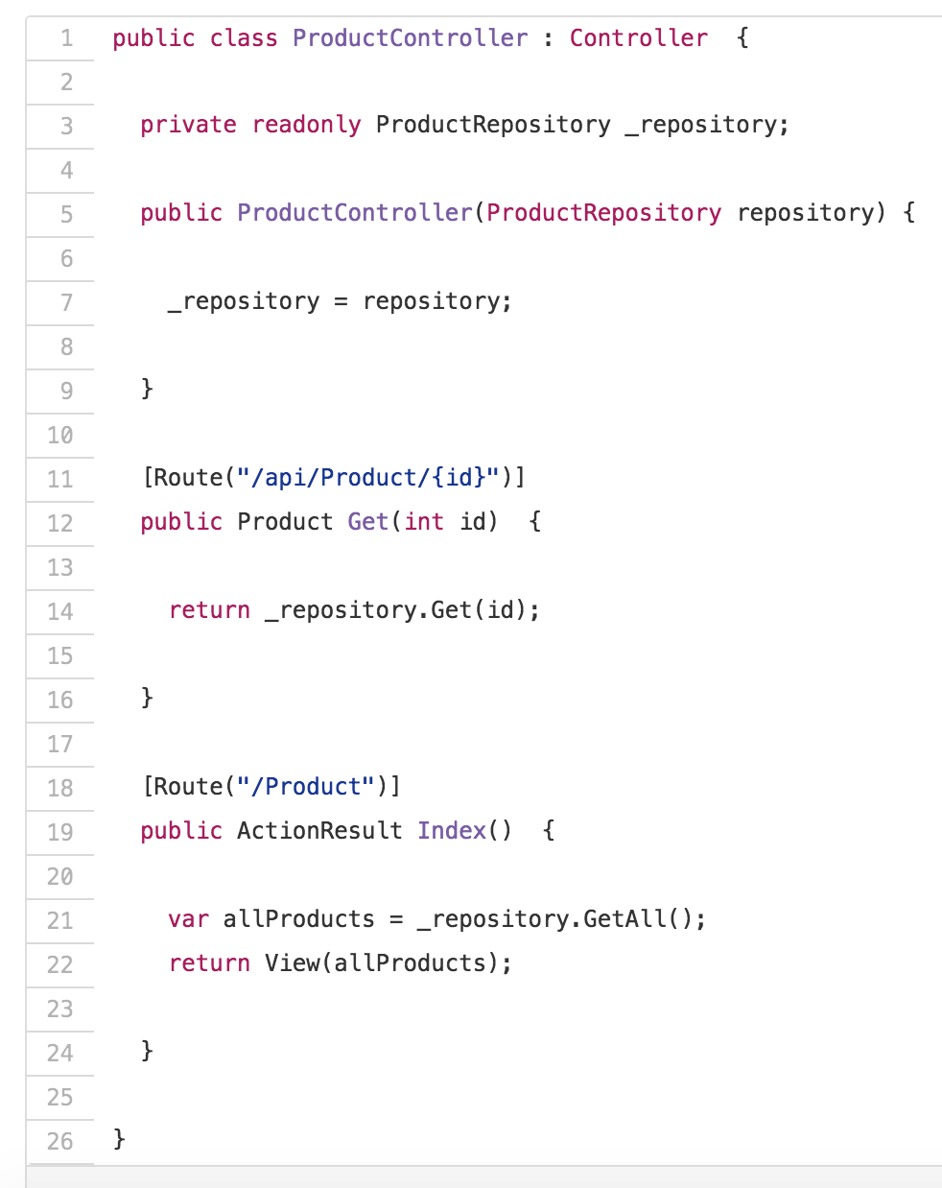
ASP.NET CORE 1.0 Feature
One Framework – MVC and WebAPI

Slide 26
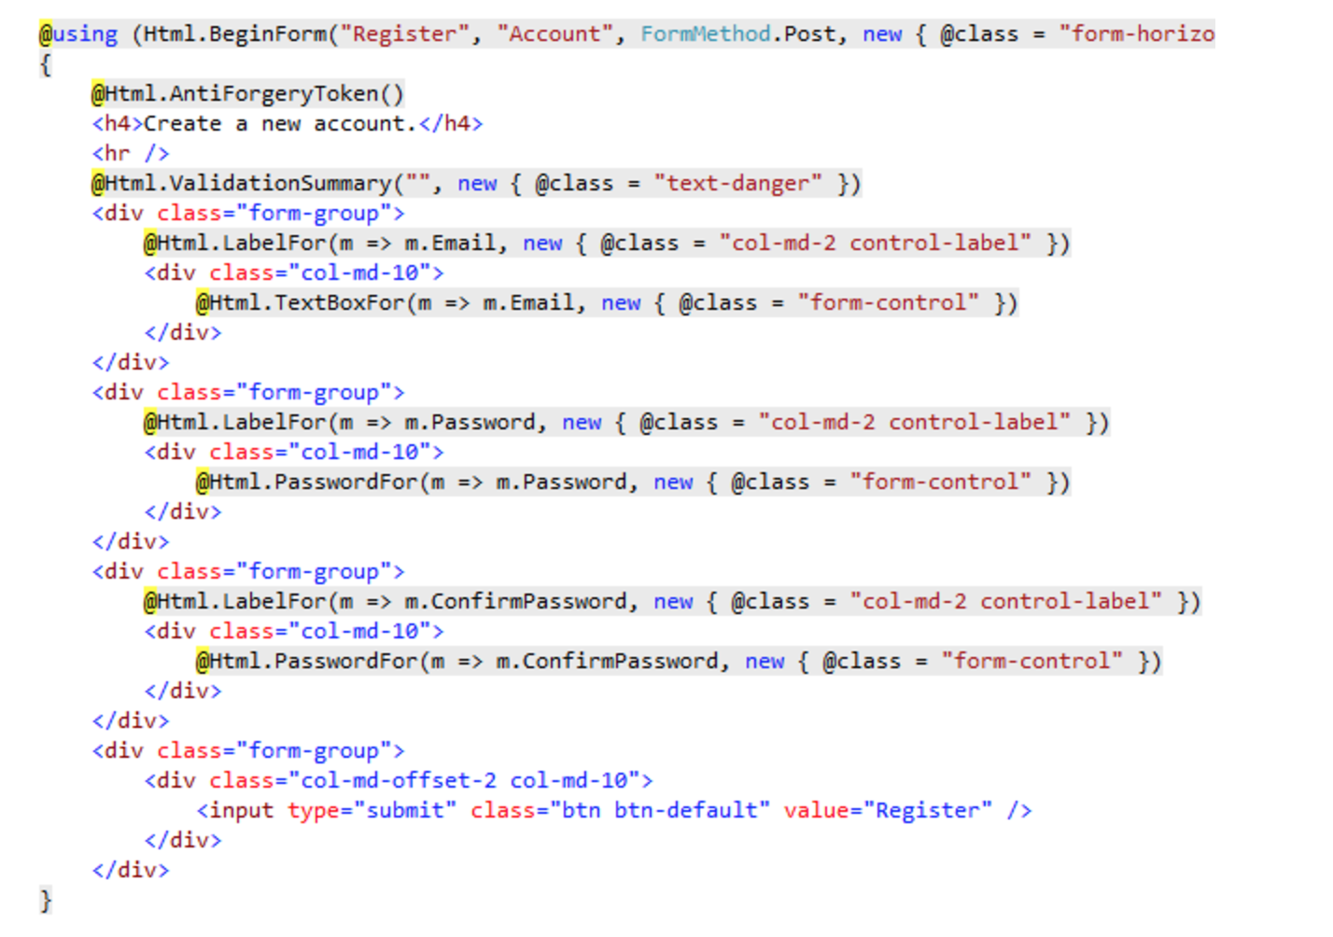
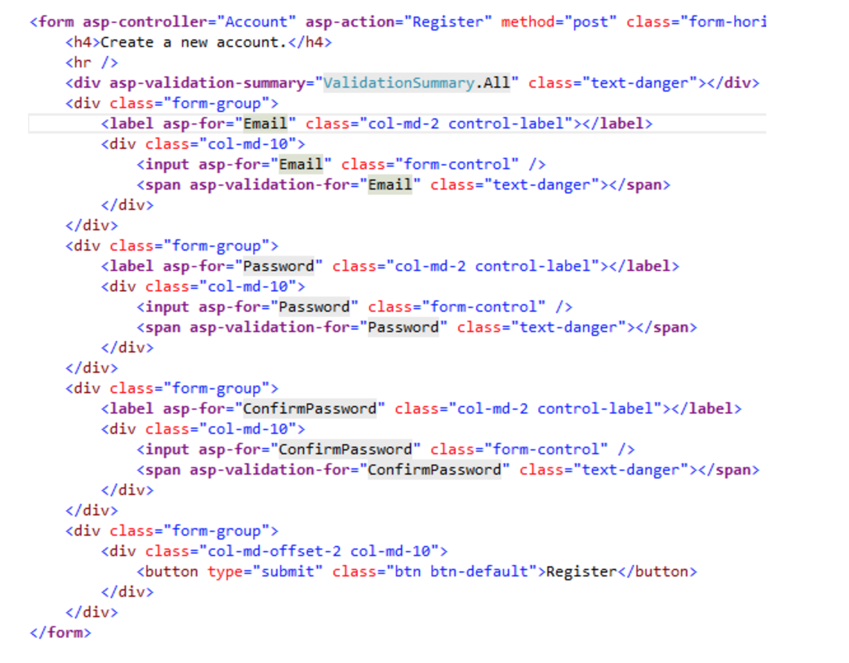
ASP.NET CORE 1.0 Feature
MVC Tag Helpers
Clean and HTML Friendly

Slide 27
EF Core 1.0
Application
Full .NET (Console, WPF, WinForms, and ASP.NET 4)
Universal Windows Platform (UWP)
ASP.NET Core
.NET Core (Windows, OSX, Linux, etc.)
Supported databases
Microsoft SQL Server
SQLite
Postgres (Npgsql)
SQL Server Compact Edition
InMemory (for testing purposes)
DevArt has paid providers for MySQL, Oracle, and many other databases
Known Issues
EF Core: Some queries significantly slower when executed async release-note
EF Core: Pre-RTM migrations may need maxLength added to string columns release-note
EF Core: Commands on UWP projects require manually adding binding redirects release-not

Slide 28
Support
Long Term Support (LTS) releases a major release, such as “1.0” or “2.0”
Supported for three years after the general availability date of a LTS release
And one year after the general availability of a subsequent LTS release
Fast Track Support (FTS) releases a minor release, such as “1.1” or “1.2”
Supported within the same three-year window as the parent LTS release
And three months after the general availability of a subsequent FTS release
And one year after the general availability of a subsequent LTS release
Notes:
If you want to deploy apps on very stable releases and do not want new features until the app is developed again. You should consider LTS releases.
If you want to take advantage of new features as soon as possible, particularly for apps that are almost always in development. You should consider FTS releases.

Slide 29
What’s new .NET Core 1.1
Announce on November 16, 2016
.NET Core: Add distros and improve performance.
ASP.NET Core: Improve Kestrel, Azure support and productivity.
EF Core: Azure and SQL 2016 support.

Slide 30
.NET Standard 2.0
.NET Standard is a set of APIs that all .NET platforms have to implement. This unifies the .NET platforms and prevents future fragmentation.
Implemented by .NET Framework, .NET Core, and Xamarin. For .NET Core, this will add many of the existing APIs that have been requested.
.NET Standard 2.0 includes a compatibility shim for .NET Framework binaries, significantly increasing the set of libraries that you can reference from your .NET Standard libraries.
Replace Portable Class Libraries (PCLs) as the tooling story for building multi-platform .NET libraries.

Slide 31
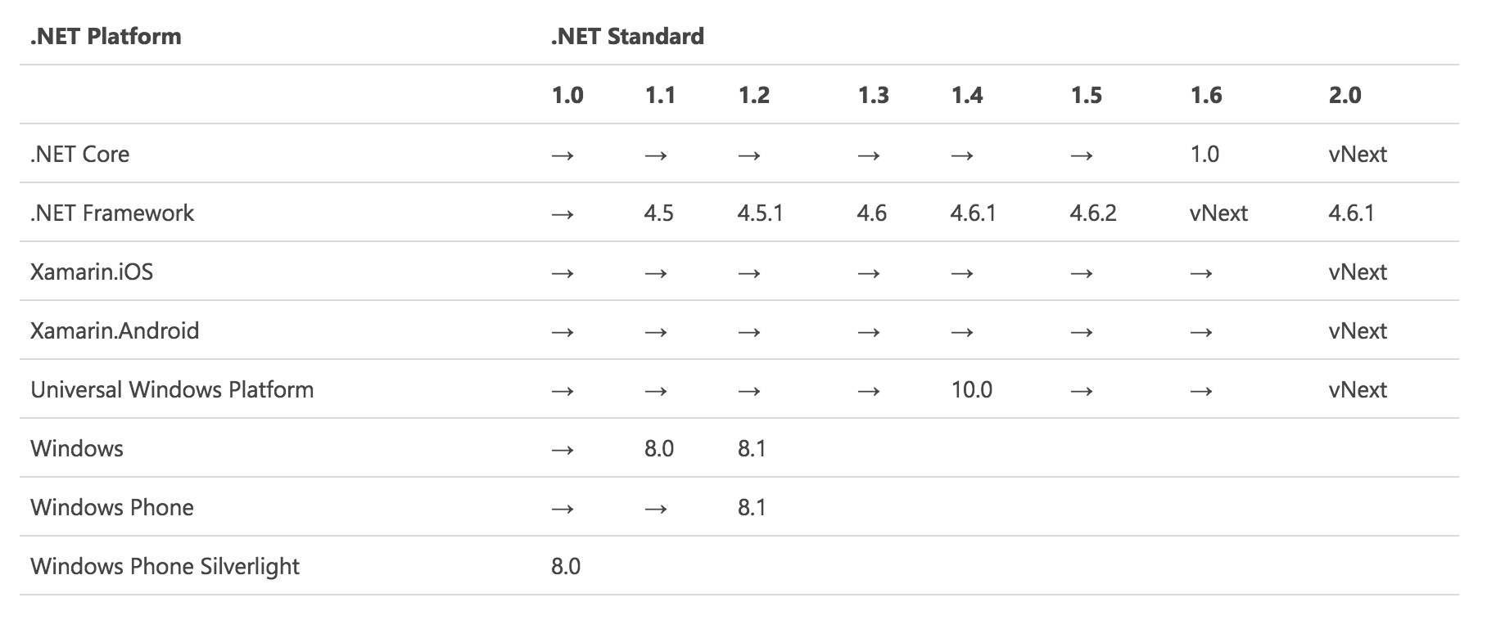
What’s new in .NET Standard 2.0

Slide 32
What’s new in ASP.NET Core 1.1
Improved and cross-platform compatible site hosting capabilities when using a host other than Windows Internet Information Server (IIS).
Support for developing with native Windows capabilities
Compatibility, portability and performance of middleware and other MVC features throughout the UI framework
Improved deployment and management experience of ASP.NET Core applications on Microsoft Azure. We think these improvements help make ASP.NET Core the best choice for developing an application for the cloud.

Slide 33
ASP.NET Core 1.1 Performance
ASP.NET Core with the Kestrel webserver in the round 13 TechEmpower benchmarks. The latest results from TechEmpower, ASP.NET Core 1.1 with Kestrel was ranked as the fastest mainstream fullstack web framework in the plaintext test.
The performance of ASP.NET Core running on Linux is approximately 760 times faster than it was one year ago. Since TechEmpower started measuring benchmarks in March 2013, they have never seen such a performance improvement as they have observed in ASP.NET Core over the last year.

Slide 34
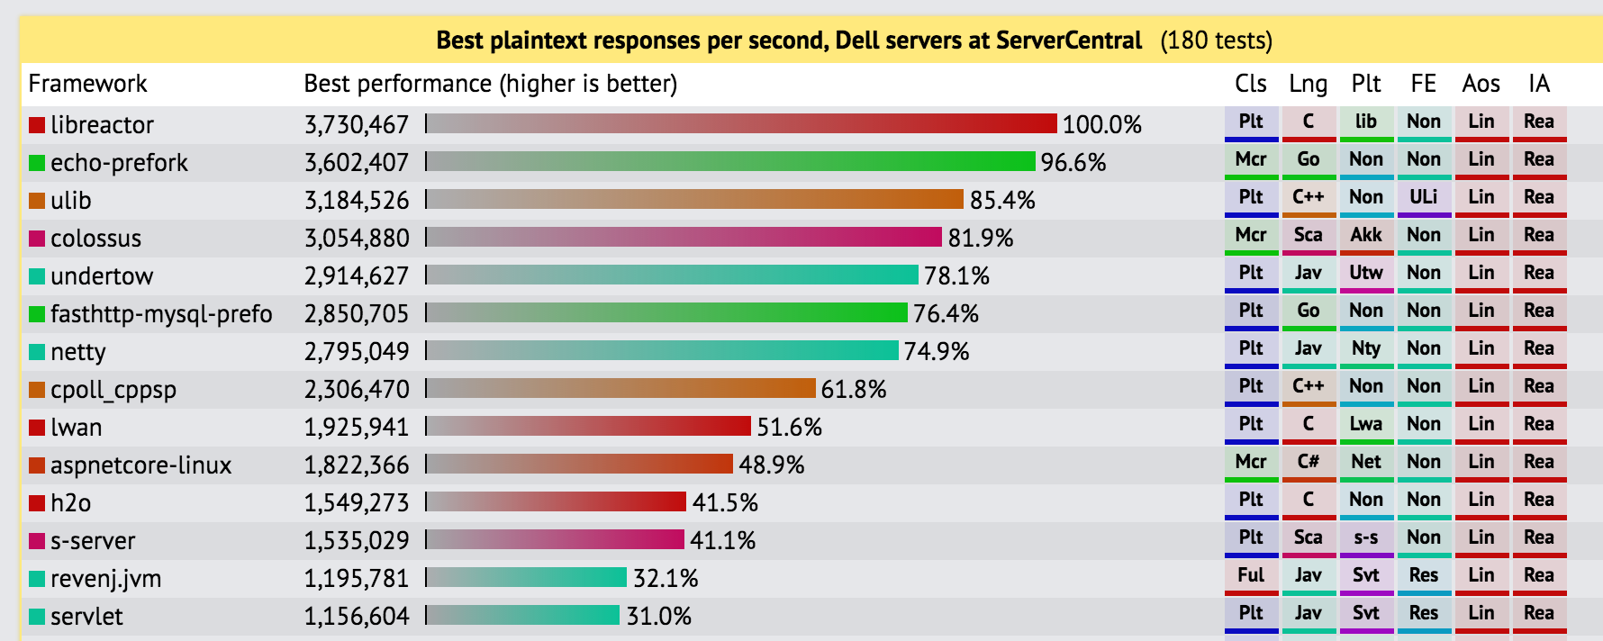
ASP.NET Core on Linux performance

Slide 35
Benchmarks
https://github.com/aspnet/benchmarks

Slide 36
.NET Core IDEs
Visual Studio 2015 with .NET Core Tools
Visual Studio 2017
Visual Studio Code
Visual Studio for Mac
Rider by Resharper

Slide 37
Demo .NET Core 1.1
Console
Unit Test
ASP.NET Core

Slide 38
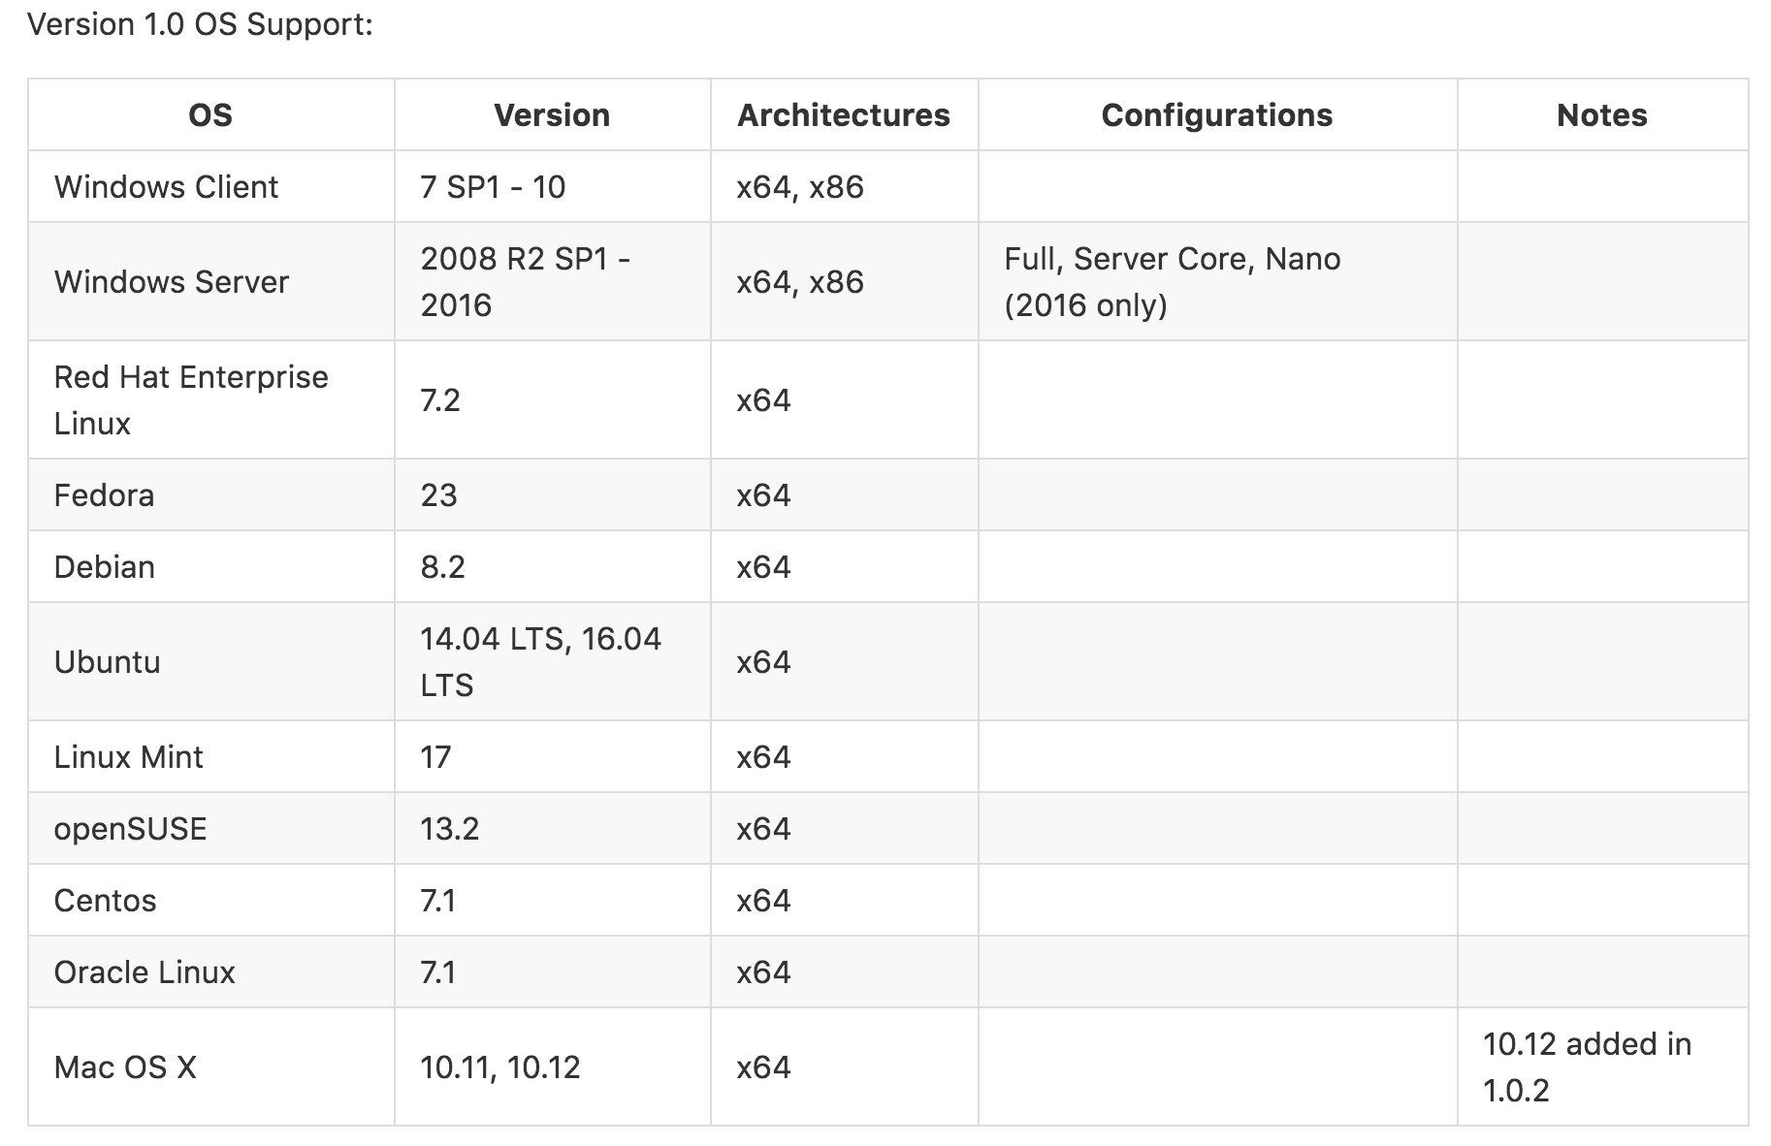
.NET CORE 1.x OS Supports

Slide 39
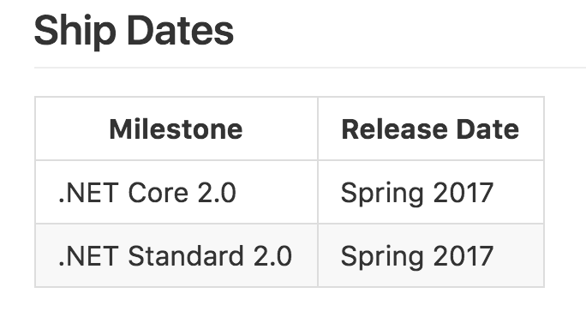
Summary

Slide 40
Summary
https://www.microsoft.com/net
https://twitter.com/dotnet
https://github.com/dotnet
https://dotnetfoundation.org/
https://dotnetfoundation.org/blog/google-join-tsg

